Slide 1









Chongqing University of Technology
ATAI
Advanced Technique of Artificial Intelligence
Chongqing University of Technology
An Attention-based Graph Neural Network for Heterogeneous Structural Learning （AAAI 2020）
论文链接：https://arxiv.org/abs/1912.10832
代码链接：https://github.com/didi/hetsann
Zhanwang Peng

Slide 2
Outline
Introduction
Approach
Experiments
Conclusion

Slide 3
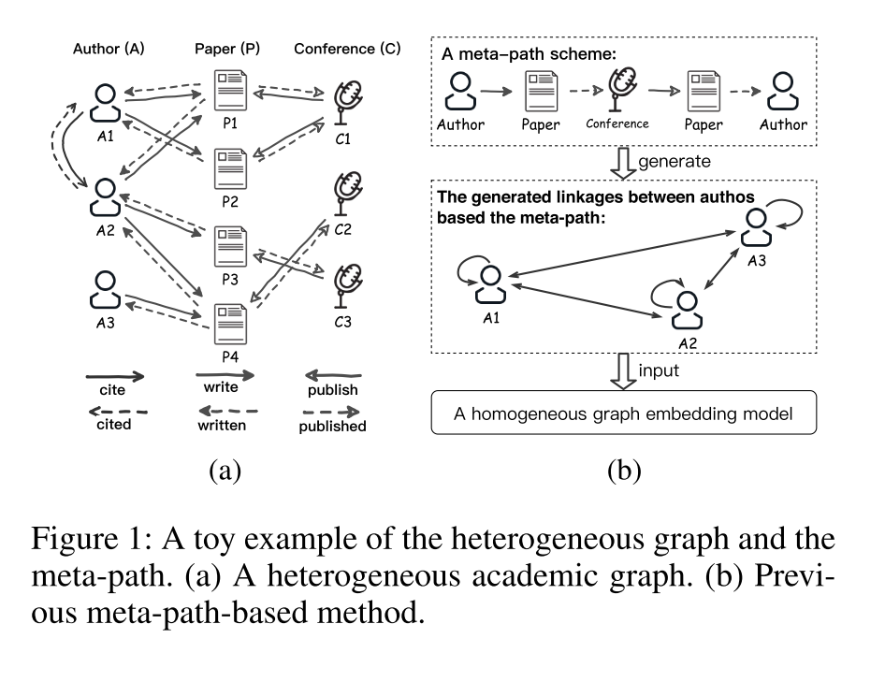
Introduction

Slide 4
Introduction
Two predominant problems of meta-path:
the scheme of meta-path relies on experts, and it is hard to exhaustively enumerate and select valuable meta-path schemes by hand
the information passing by the meta-path, such as features of heterogeneous nodes or edges, is lost in the process of generating meta-path based node pairs, and it may even lead to an inferior embedding performance

Slide 5
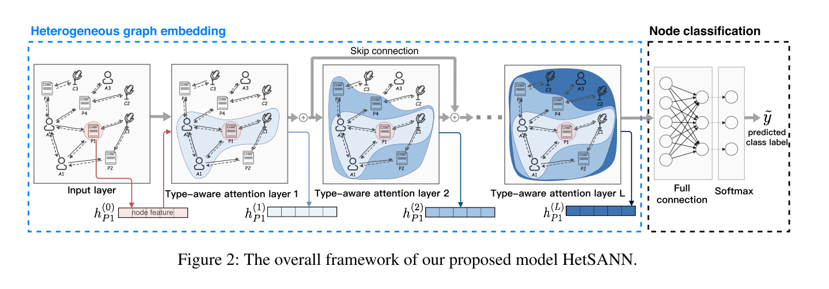
Approach

Slide 6






Approach
The basic concept:
Target:

Slide 7
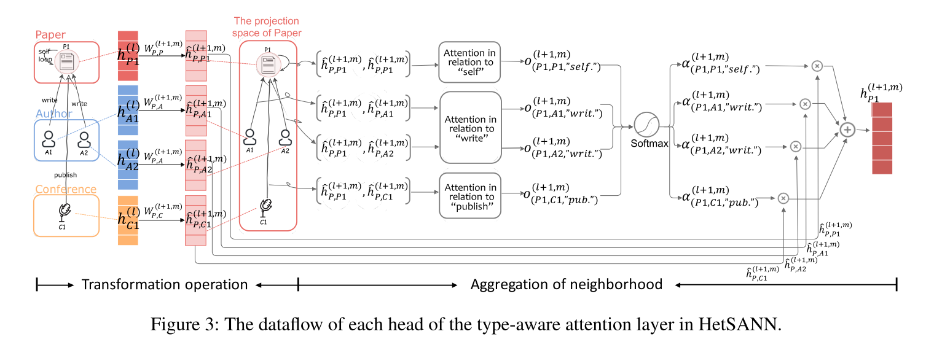
Approach

Slide 8



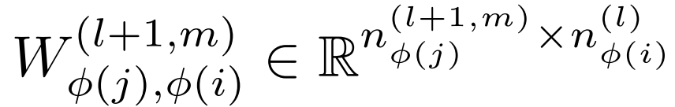
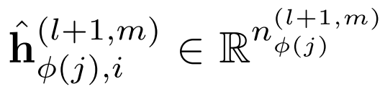
Approach
Transformation Operation:

Slide 9
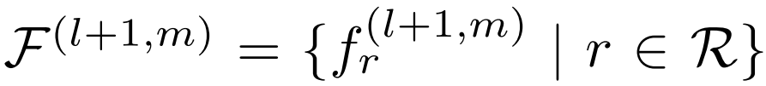
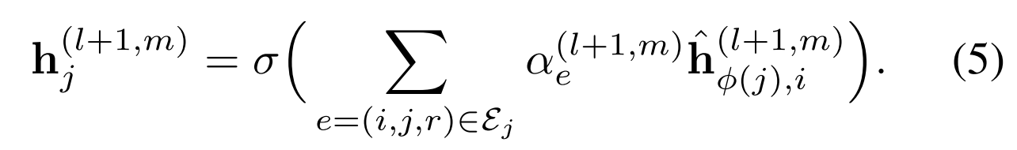
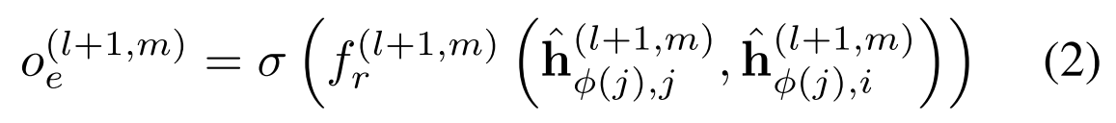
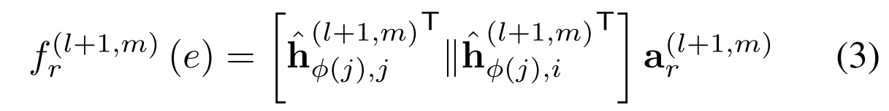
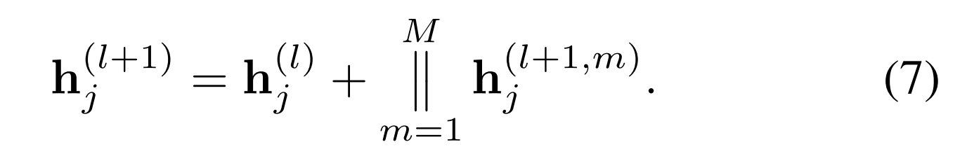
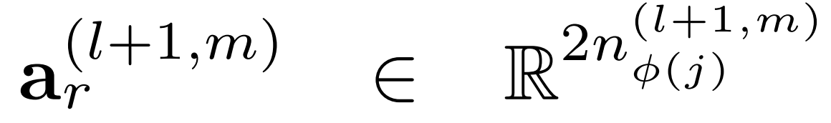

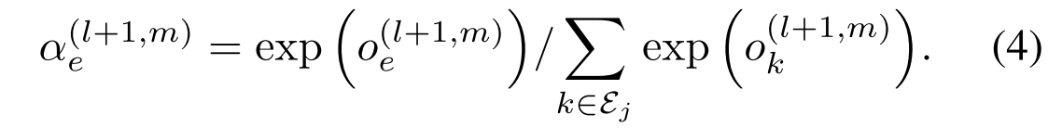

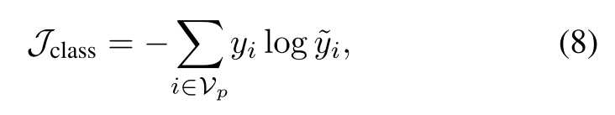
Approach
Transformation Operation:
注意力打分函数：
=softmax(full-connection($h_{j}$))

Slide 10



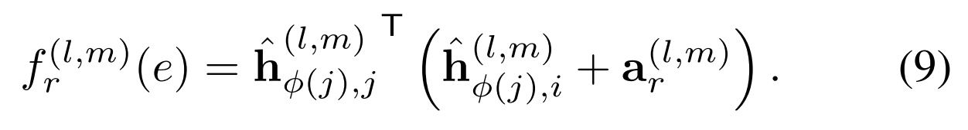
Approach
Three kinds of extension:
调整注意力打分函数：

Slide 11

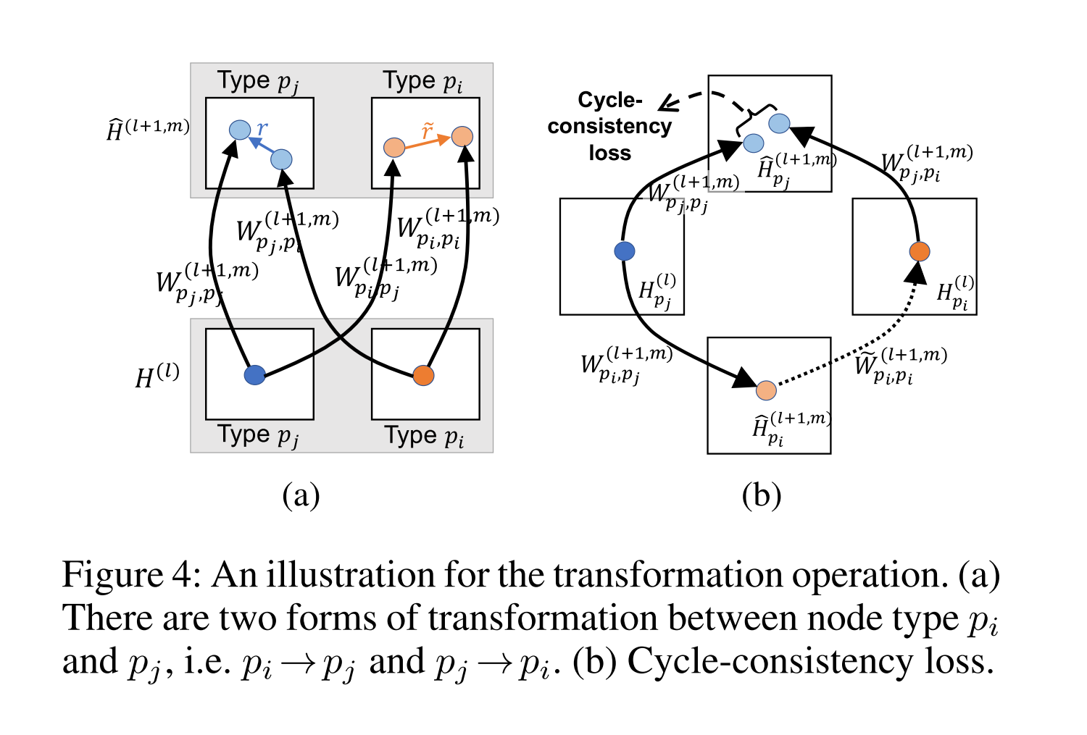
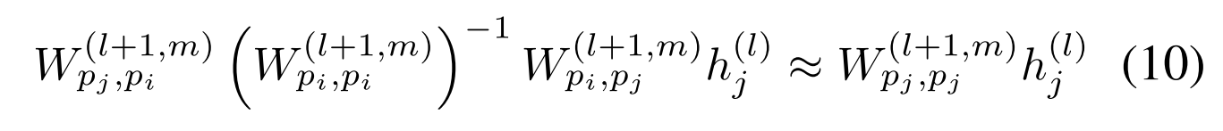
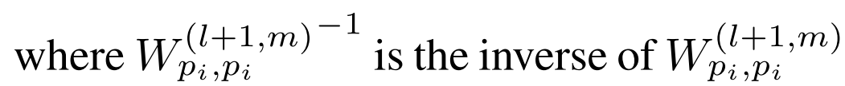
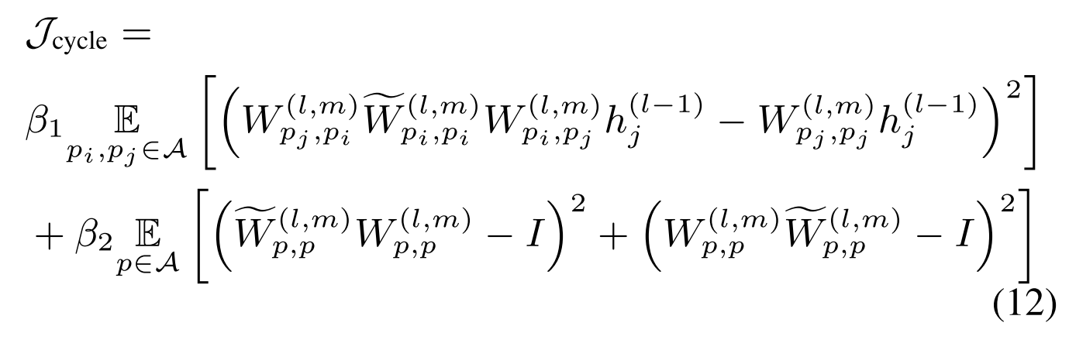
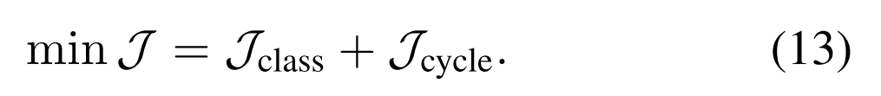
Approach

Slide 12
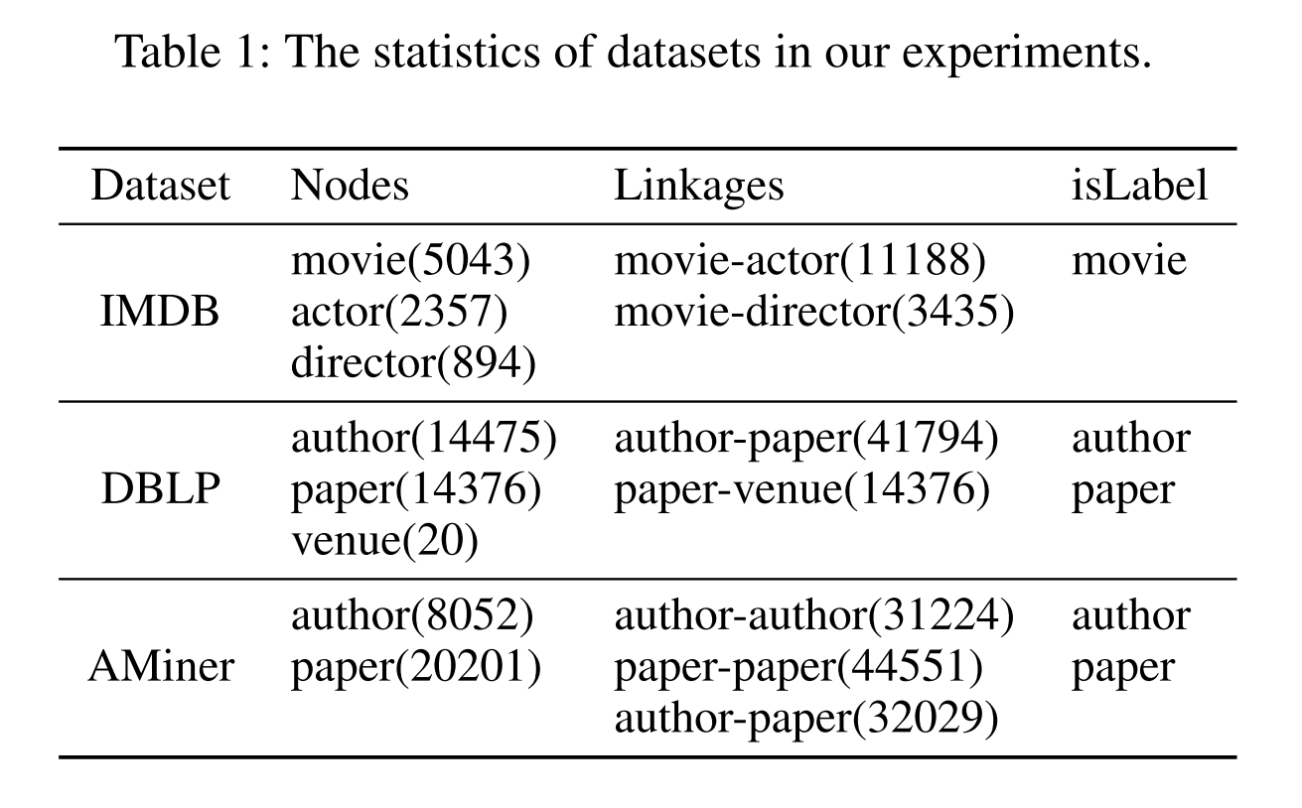
Experiments

Slide 13
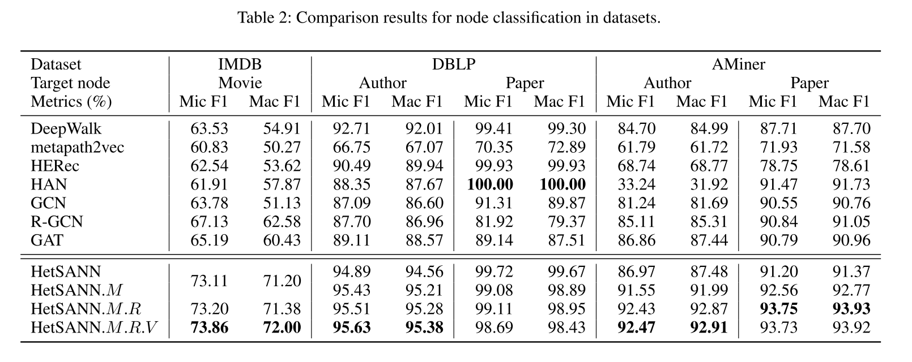
Experiments

Slide 14
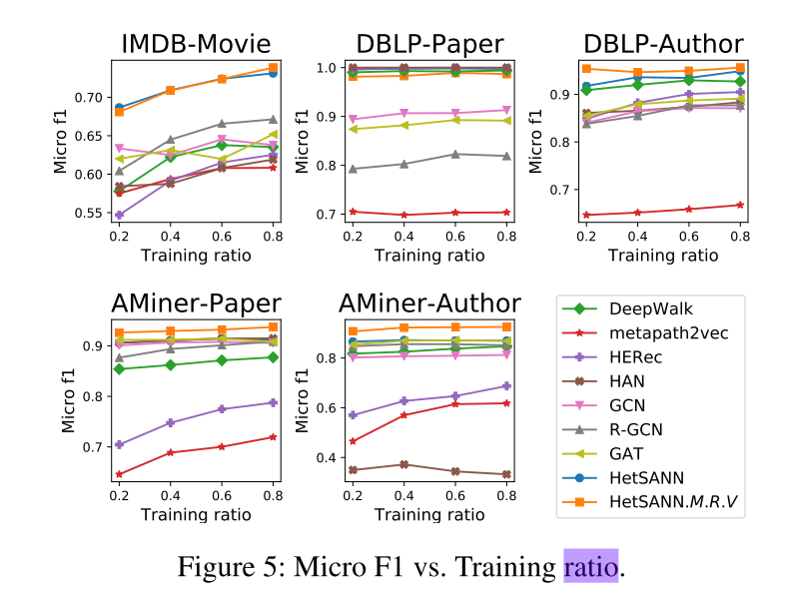
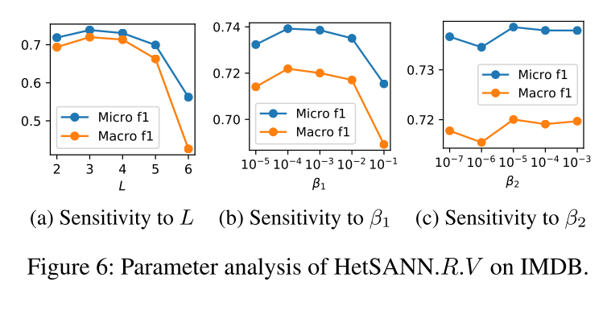
Experiments

Slide 15
Thanks

